Slide 1

Graph Theory Introduction

Slide 2
Subgraphs
Types of Subgraphs
Walk, Path, Cycle
Connected graphs
connectivity

Slide 3
Subgraphs
A subgraph of a graph G=(V(G),E(G)) is a graph H=(V(H),E(H)) with V(H)⊆ V(G) and V(H) ⊆ V(G). We also say that G contains H.

Slide 4
Subgraphs - Example
G=(V,E)
VG ={1,2,3,4}
EG = {a,b,c,d,e} Let: U = {1,2,3}, W =
{2,3,4}, F = {b}, P =
{a,d}. Then (U,P) and (W,F) are subgraphs while (U,F) and (W,P) are not.
a
1
2
c
b
d
e
3
4

Slide 5
Spanning Subgraph
If H=(U,F) is a subgraph of G(V,E) and U = V, then H is called a spanning subgraph of G.

Slide 6
Trivial Subgraph
Subgraph H is trivial, if either H = φ, or H = G.

Slide 7
Induced Subgraph
Graph H is an induced subgraph of graph G, if H is obtained from G by removing the vertices from V(G)-V(H).
An induced subgraph of G is determined by its vertrex set U µ V(G). If we want to distinguish the graph from its vertex set we denote the former by <U> or, if we wnat to refer to the original graph by G|U.
Example: P₅ is an induced subgraph of C₆.

Slide 8
Walk, Path and cycle
An edge progression W in G is a sequence v₁,e₁,v₂,e₂,…,v_{k},e_{k}, v_{k+1} such that k ≥ 0, and e_{i}=(v_{i}, v_{i+1})∈E(G) for i=1,…,k .
If in addition e_{i} ≠ e_{j} for all 1≤i<j≤ k, W is called a walk in
G.
W is closed if v₁= v_{k+1} .
A path is a graph P=({v₁,…,v_{k+1} },{e₁,…,e_{k}}) such that v_{i} ≠ v_{j} for 1≤i<j≤ k+1, _{f}and the sequence v₁,e₁,v₂,e₂,…,v_{k},e_{k},v_{k+1} is a walk.
A circuit or a cycle is a graph ({v₁,…,v_{k} },{e₁,…,e_{k}}) such that the sequence v₁,e₁,v₂,e₂,…,v_{k},e_{k},v₁ is a (closed) walk and v_{i} ≠ v_{j} for 1≤i<j≤ k+1.
The length of a path or circuit is the number of its
edges.

Slide 9
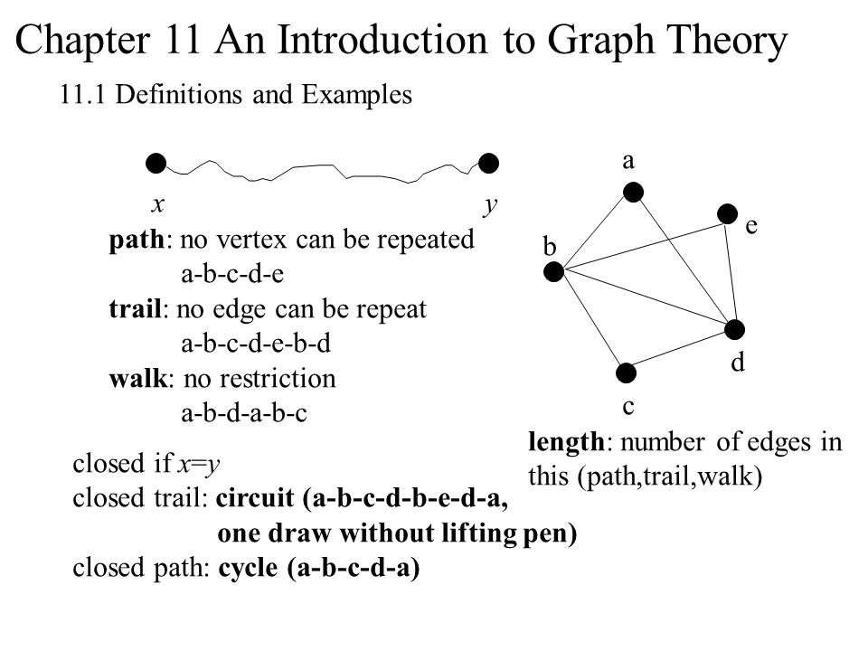

Slide 10
Connected graphs
Let G be some undirected graph. G is called connected if there is a v-w-path for all v, w ∈ V(G); otherwise G is disconnected. The maximal connected subgraphs of G are its connected components. A vertex v with the property that G – v has more connected components than G is called an articulation vertex. An edge e is called a bridge if G – e has more connected components than G.

Slide 11
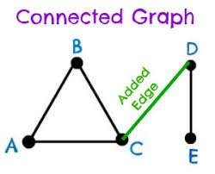

Slide 12
Distance in Connected Graph
Each connected graph G gives rise to a metric space (V,d_{G}) for d_{G}(u,v) being the length of shortest path in G, from u to v.

Slide 13
Connectivity

Slide 14
k-connectedness
Graph G with |V(G)| > k is k- connected, if a removal of any set S with |S| < k stays conneced.
Connectivity κ(G) of graph G is the largest k, such that G is still k- connected.
Vertex v of graph G is a cut-vertex, if
Ω(G – v) > Ω(G ).
A connected graph with no cut-vertex is called a block.

Slide 15
Definitions
Separating Set
Connectivity
k-connected – Connectivity is at least k
Induced subgraph – subgraph obtained by deleting a set of vertices
Disconnecting set (of edges)

Slide 16
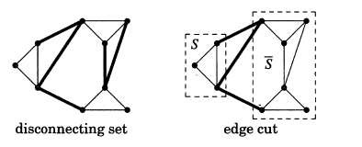
Definitions
Edge-connectivity - set
= Minimum size of a disconnecting
k-edge connected if every disconnecting set has at least k edges
Edge cut –

Slide 17

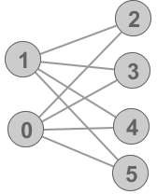
Examples
Consider a bipartition X, Y of
Since every separating set contains either X or Y which are themselves a separating set, ^{[1]}

Slide 18
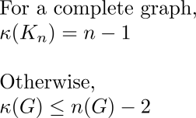
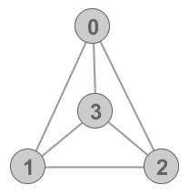

Examples

Slide 19
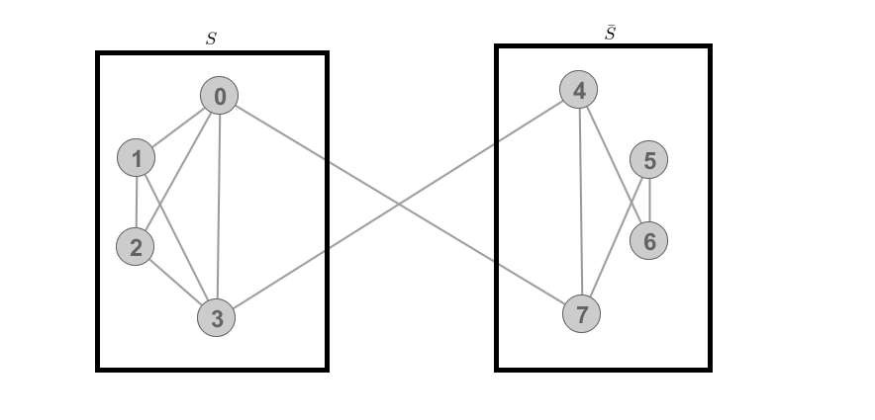
Example of Edge Cut

Slide 20
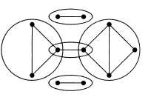
Definitions
Block – A maximal connected subgraph of G that has no cut-vertex.

Slide 21

Ego Network Analysis

Slide 22


Definitions
Ego network (personal network)
Ego: focal node/respondent
Alter: actors ego has ties with
Ties between alters
A
B
Ego
D
C

Slide 23
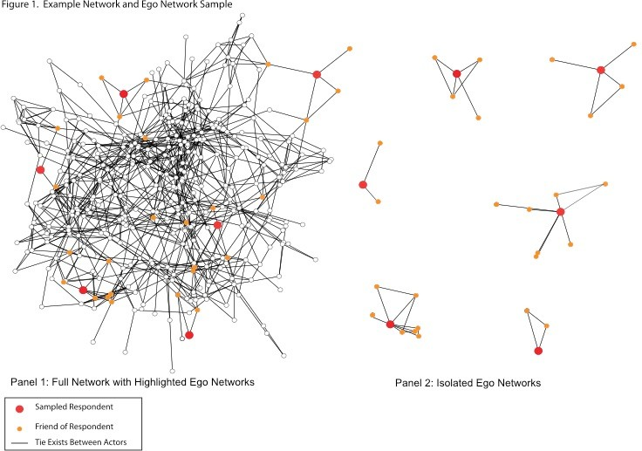

Slide 24

Ego Networks and Traditional Survey Data
Ego networks combine aspects of traditional survey data with network data
Traditional survey
Independently sampled respondents
Get characteristics of those respondents through survey questions
Respondent | Age | Educ | Smokes | Drinks
Ego | 40 | 16 | No | Yes

Slide 25
Ego Networks and Traditional Survey Data
Ego networks combine aspects of traditional survey data with network data
Respondent | Age | Educ | Smokes | Drinks
Ego | 40 | 16 | No | Yes
 | Ego | A | B | C | D
Ego |  | 1 | 1 | 1 | 1
A | 1 |  | 1 | 0 | 1
B | 1 | 1 |  | 0 | 0
C | 1 | 0 | 0 |  | 0
D | 1 | 1 | 0 | 0
A
B
Ego
D
C

Slide 26

Why use ego network data?
From ego’s perspective, personal network is important for:
Social support
Access to resources
Influence/normative pressure

Slide 27

Why use ego network data?
From a more global perspective, ego network data are useful for:
Studying mixing patterns between groups
Potential for diffusion
Disease propagation
Adoption of innovation: new product or health practice

Slide 28

Why use ego network data?
Lots can be had from ego network data!
Composition of individual’s local social world
Demographic characteristics of alters
Shared health behaviors
Structural features
Size
Density
Nature of the ties
Frequency, duration, closeness
Specific exchanges

Slide 29
Cost/Benefits to Ego Network Data
Benefits:
Lots of information for cheap
Easy to collect as part of a traditional survey
Often only interested in personal networks
Can use local information to describe global network properties
Costs:
Rely (typically) on self reports of ties
Egos are treated as independent
Will generally miss larger structure of network

Slide 30

Collecting Ego Network Data
1) Could collect full network data
extract ego networks
analyze as independent
Beth
Alice | Alice | Beth
Alice |  | 1
Beth | 1
Beth | Beth | Alice | Carl | Diana
Beth |  | 1 | 1 | 1
Alice | 1 |  | 0 | 0
Carl | 0 | 0 |  | 1
Diana | 0 | 0 | 1
Alice
Carl
Diana
Fred
Ed

Slide 31
2) More typical is to collect independently sampled ego network data
Random sample of individuals
Ask standard survey questions (age, education)
Ask each person to report on
alters
alter characteristics
ties between alters

Slide 32

Step 1
Each respondent is asked to list set of contacts
No need for actual names or ids
Often truncated but best not to
Generally a good idea to ask multiple questions

Slide 33

Step 1
Ask open ended questions to elicit social contacts
General: Looking back over the last six months who are the people with whom you discussed an important personal matter?
Behavioral: Who have you shot up with in the last 6 months?
Support: If you were sick, who would be willing to accompany you to the hospital? Who do you go to for advice on health-related matters?

Slide 34

Step 2
Ask respondents about each named alter
Characteristics
age, education, gender…
Nature of tie with alter
Frequency of contact
Kin/non-kin, type of relationship
Closeness to alter
Duration of relationship
 | Age | Educ | Age Alter1 | Age Alter2 | Educ Alter1 | Educ Alter2 | Freq Alter1 | Freq Alter 2
Ego | 40 | 16 | 38 | 35 | 16 | 12 | Weekly | Monthly

Slide 35

Step 3
Ask respondent about ties between alters (if possible)
Think about the relationship between <alter1> and <alter2>. Would you say that they are strangers, just friends, or especially close?
 | Age | Educ | Age Alter1 | Age Alter2 | Educ Alter1 | Educ Alter2 | Freq Alter1 | Freq Alter 2 | Tie: A1- A2?
Ego | 40 | 16 | 38 | 35 | 16 | 12 | Weekly | Monthly | Close
■
Oft
en m
ust lim
it n
umbe
r of a
lter-a
lter ti
e
que
stio
ns

Slide 36

Analyzing Ego Network Data
Different kinds of questions/analyses than with full network data
Often measure property of ego network to use as predictor in typical statistical model

Slide 37








Network Size (Degree)

Slide 38
Network size: Local and Global Measures
Local: personal network size
Number of alters (social support) predicting health outcomes
Number of drug partners predicting future risky behavior
Global: degree distribution by aggregating over all cases
Distribution of ties per person

Slide 39
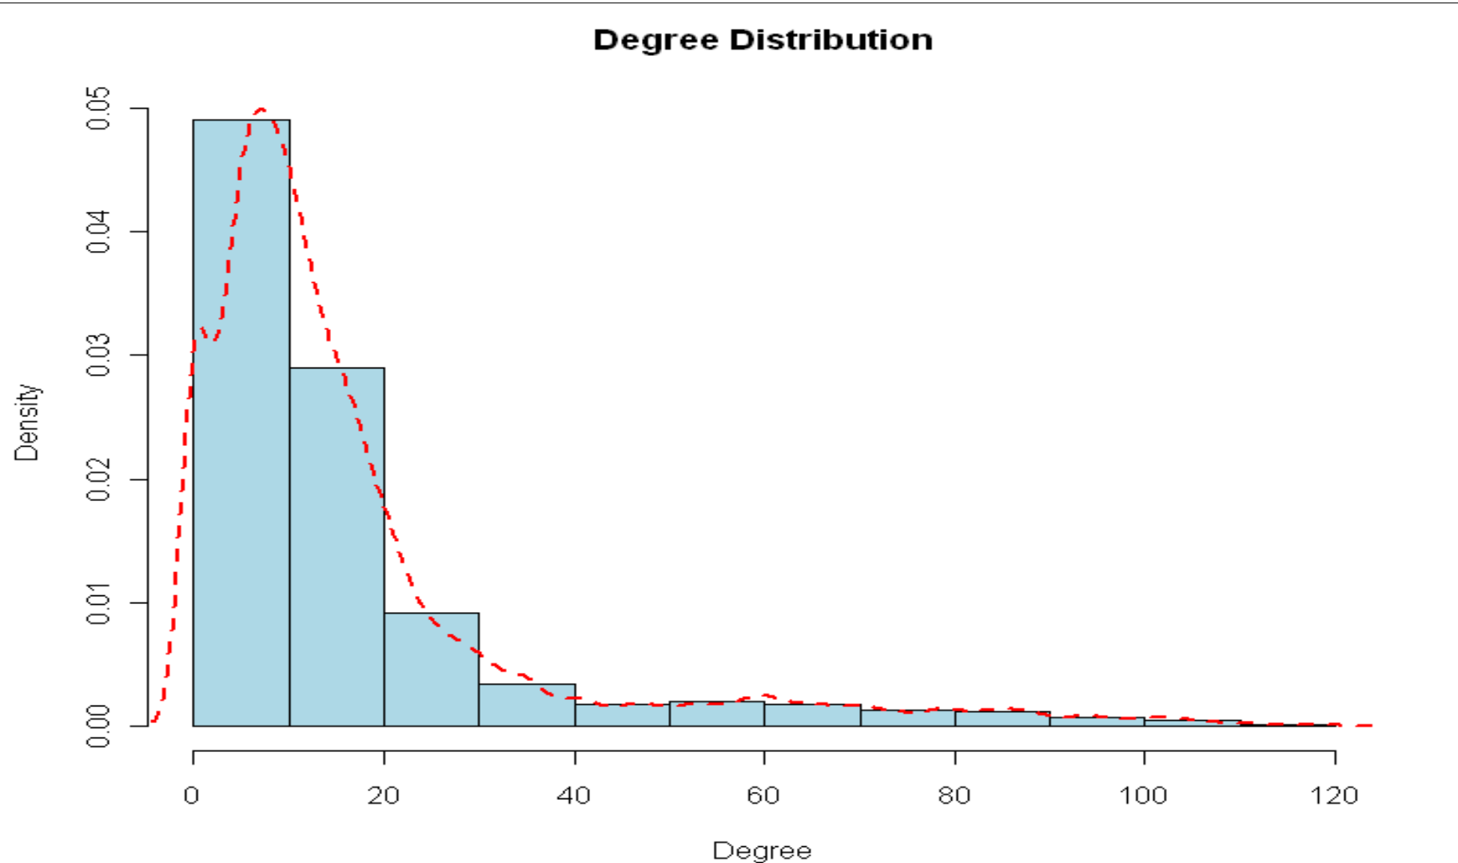

Slide 40

Composition
Distribution of types of people and resources in ego network
Demographic characteristics
Types of relationships (kin/non-kin)
Resources available to ego
Risks to ego

Slide 41

Demographic characteristics
Homophily tends to prevail
Ego networks are more homogenous than population at-large
Largely due to structural constraints
Local: How diverse/homogenous is an individual’s social world?
Global: How much contact is there between demographic groups?

Slide 42
Local: How diverse/homogenous is an individual’s social world?
What proportion of ego’s friends are white? Female? What proportion of ego’s friends are of different gender than themselves?
Global: How much contact is there between demographic groups?
What proportion of ties are between/within racial groups?

Slide 43

Homophily
How similar is ego to their alters?
Two simple measures (just focus on ego- alter pairs):
proportion homophilous
E-I index:
𝐸 − 𝐼
𝐸 + 𝐼
Where E= number of ties to different groups
And I=number of ties to same group
Ranges from -1 (homophily) to 1

Slide 44






𝐸 − 𝐼
𝐸 + 𝐼
E=0 I=4
E-I: (0-4)/4=-1
Proportion homophilous: Proportion same/degree 4/4=1
E=2 I=2
E-I: (2-2)/4=0
𝐸 − 𝐼
𝐸 + 𝐼
Proportion homophilous: Proportion same/degree 2/4=.5

Slide 45


Heterogeneity
Could also measure heterogeneity amongst alters (ignore ego here)
e.g., diversity of social support or job contacts may be advantageous
IQV as one possible measure:
Where k is the number of categories and p is the proportion in category i

Slide 46

Resources and Risks
We can use the same measures on other characteristics of interest, such as:
Distribution of drugs users in network (risks)
Distribution of income/education, kin, etc. in network (resources)
Distribution of health statuses (chronic illness) in network (i.e., stressors)

Slide 47

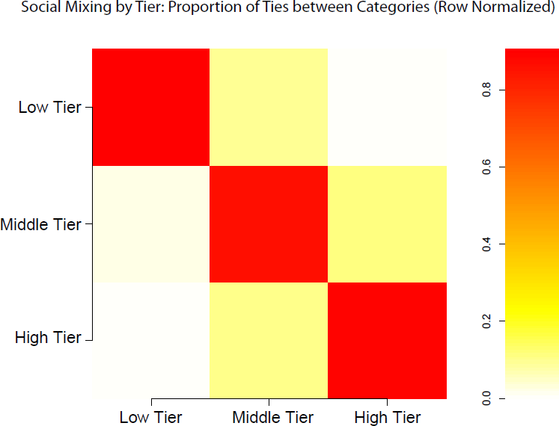
Global Measures

Slide 48
Table 1. Summary Statistics
 |  | 1985 |  |  |  | 2004
 | Mean |  | SE |  | Mean |  | SE
Race Racial Mismatch between Respondent and | .047 |  | .006 |  | .098 |  | .010
Racial Mismatch Expected by Chance∗∗∗ | .276 |  | .015 |  | .387 |  | .020
Religion Religious Mismatch between Respondent | .241 |  | .010 |  | .290 |  | .014
Religious Mismatch Expected by Chance∗∗∗ | .535 |  | .011 |  | .658 |  | .013
Sex Sex Mismatch between Respondent and | .403 |  | .008 |  | .433 |  | .011
Sex Mismatch Expected by Chance | .498 |  | .003 |  | .492 |  | .005
Confidant∗∗∗
and Confidant∗∗
Confidant∗
Age
Absolute Age Difference between Respondent and Confidant
Absolute Age Difference Expected by Chance∗∗
11.792
.234
11.150
.283
19.839
.287
18.584
.354
Education
Absolute Education Difference between Respondent and Confidant
Absolute Education Difference Expected by Chance
2.115
.049
2.047
.058
3.317
.084
3.120
.079
Note: The table includes significance tests comparing the level of homophily in 1985 to the level in 2004. The level of significance is placed next to the name of the statistic. Standard errors are calculated from bootstrap samples for the observed level of homophily, and using complex survey design for the level expected by chance.
∗p < .05; ∗∗p < .01; ∗∗∗p < .001 (two-tailed tests).
Smith et al. 2014

Slide 49

Structural Measures
Measuring structural features of ego network
Use alter-alter ties+network size
Different network environments lead to different outcomes
Norms easier to establish/maintain if all friends know each other (stronger social closure)

Slide 50





Density
Like normal density but ignore ego-alter ties
Proportion of ties between alters compared to number possible
Total Ties=1 Possible=4*3/2=6 Density=1/6

Slide 51
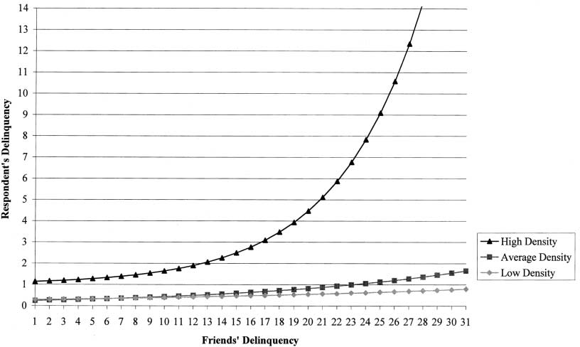
Fig. 1.—Interaction: density by friends’ delinquency
Haynie 2010

Slide 52

Structural Holes (Burt)
Basic idea is that ego may be in an advantageous position if they have lots of non-redundant ties
More diverse information
Broker between two groups

Slide 53
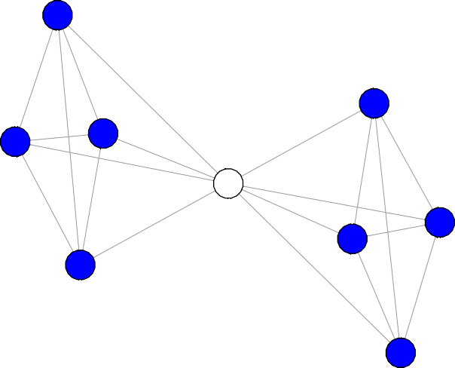
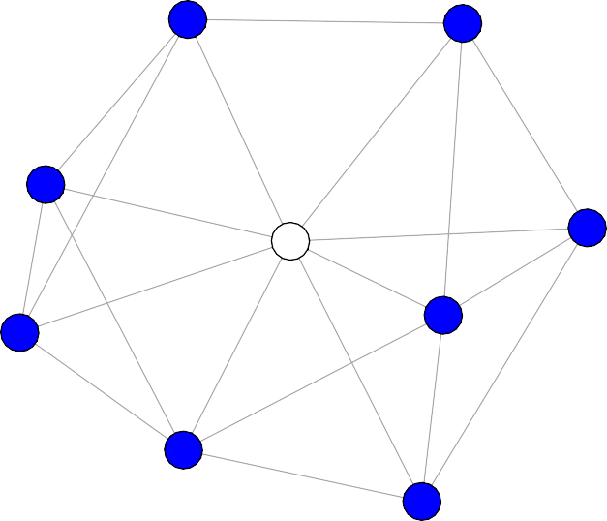

Slide 54

Effective Size
Effective size=number of alters- ‘redundancy’ with alters
n-2t/n
Where n=number of alters t=number of ties between alters
2
4
6
1
ego
6-(2*4)/6=4.67
5
3

Slide 55

Efficiency
Efficiency =
Effective Size/actual size
2
4
6
4.67/6=.78
1
ego
5
3

Slide 56





Constraint
How much room to exploit structural holes
To what extent is ego tied to people who are
2
also connected to each other 𝑐
= 𝑝 + 𝑝 𝑝
ij ij 𝑞 i𝑞 𝑞j
Less room to navigate if everyone tied to everyone
Low Constraint Higher Constraint

Slide 57

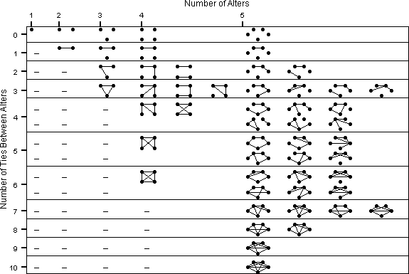
A Configurational Approach
Smith 2012

Slide 58
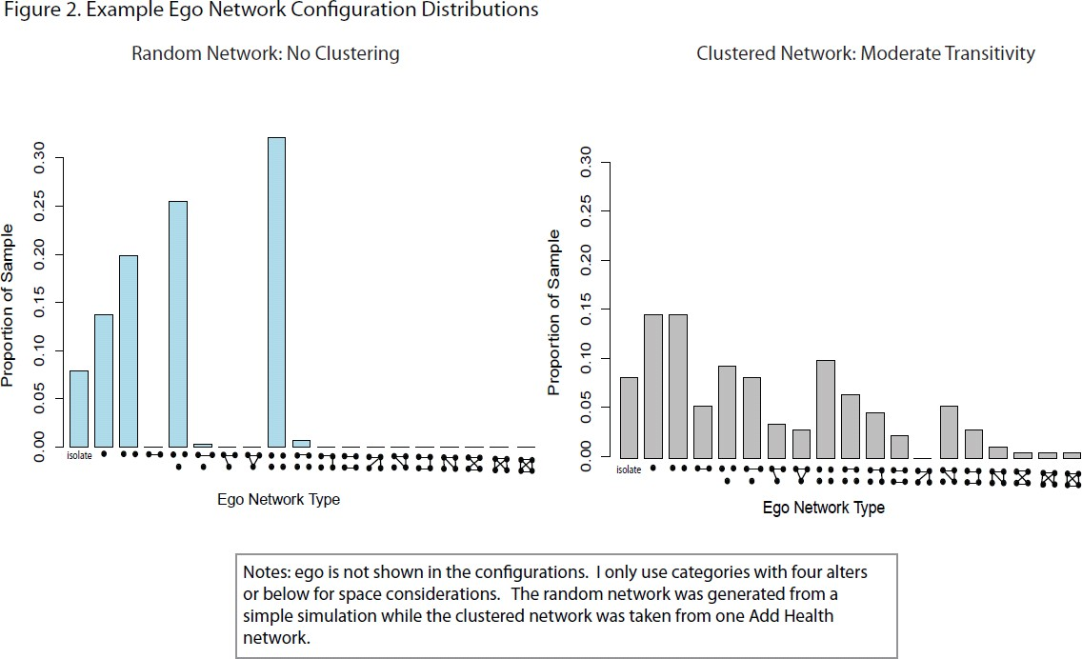

Slide 59
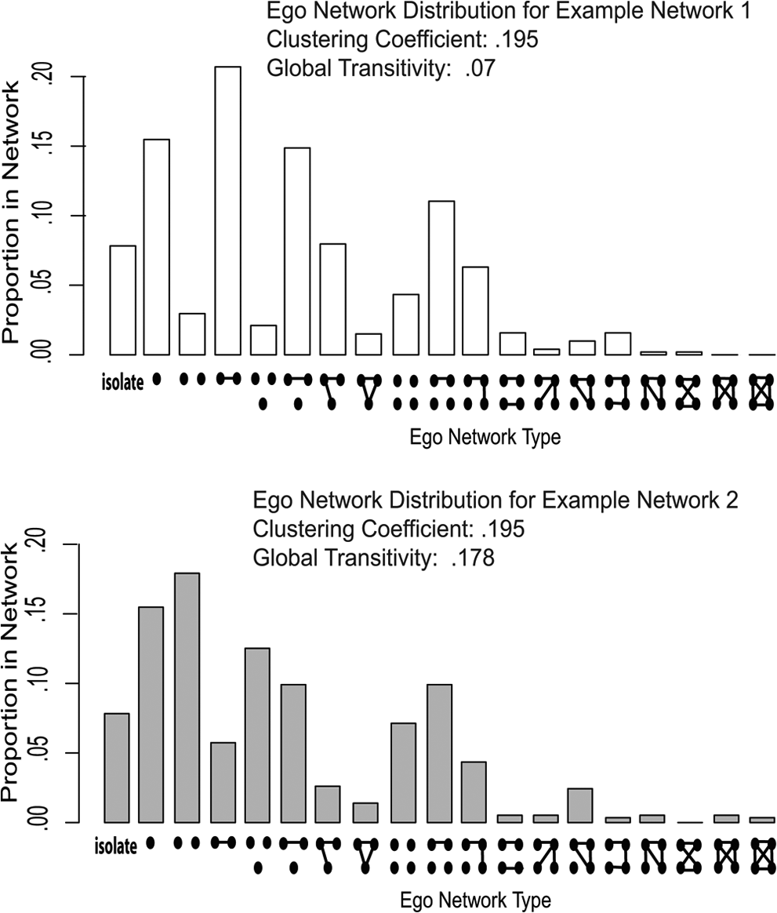

Slide 60

Analysis Part II: getting global network features from ego network data
Take ego network data and measure:
Degree distribution, mixing between groups,, differential degree and (possibly) ego network configuration distribution
Simulate full networks of the right size (using ERGM-more on this Thursday!) where ego networks have same properties as observed ego networks

Slide 61
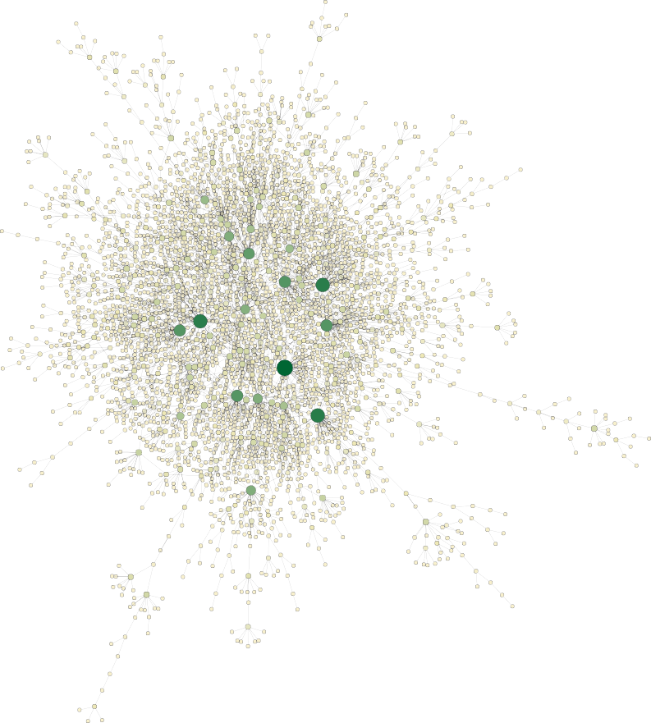
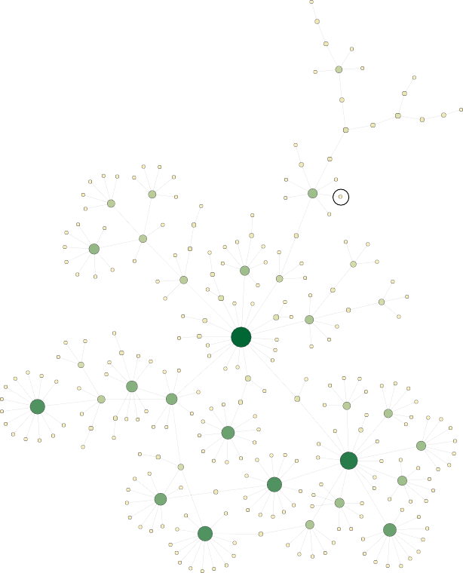
Degree
1 60
Fig. 6 Single run of largest component (left) and one eight-step walk from a randomly chosen node (right)
Merli et al. 2015

Slide 62
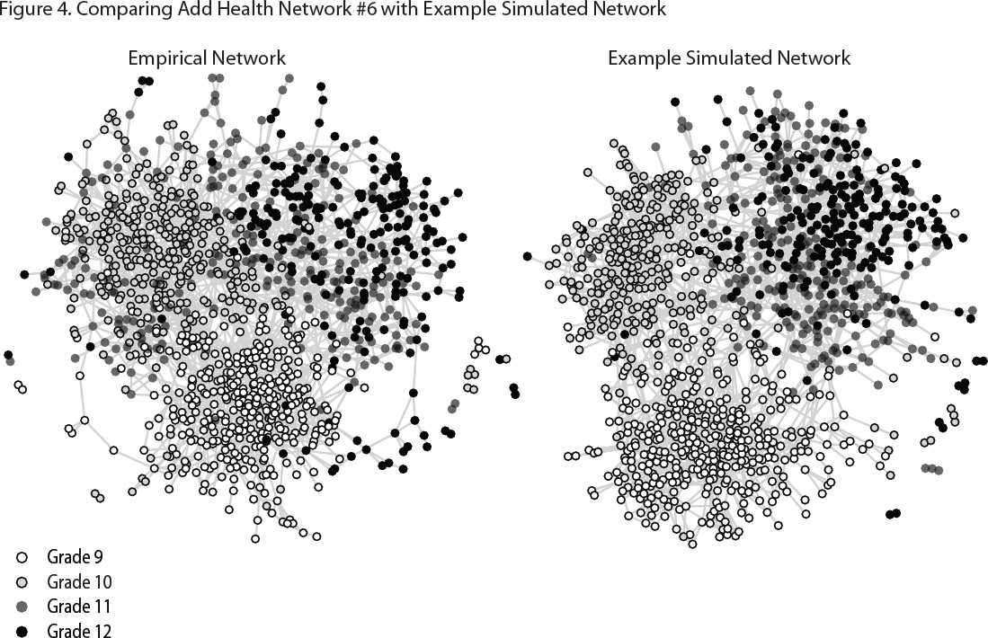
Smith 2012

Slide 63
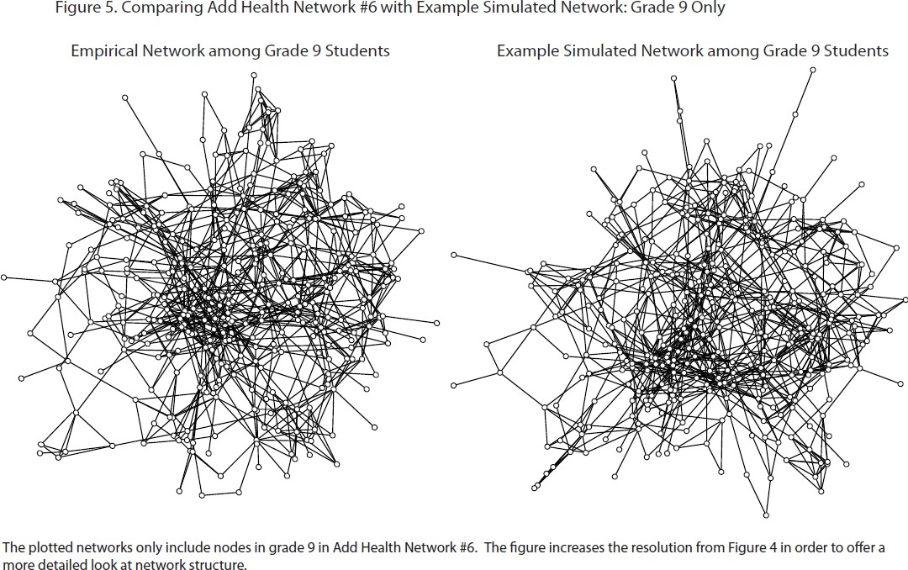

Slide 64
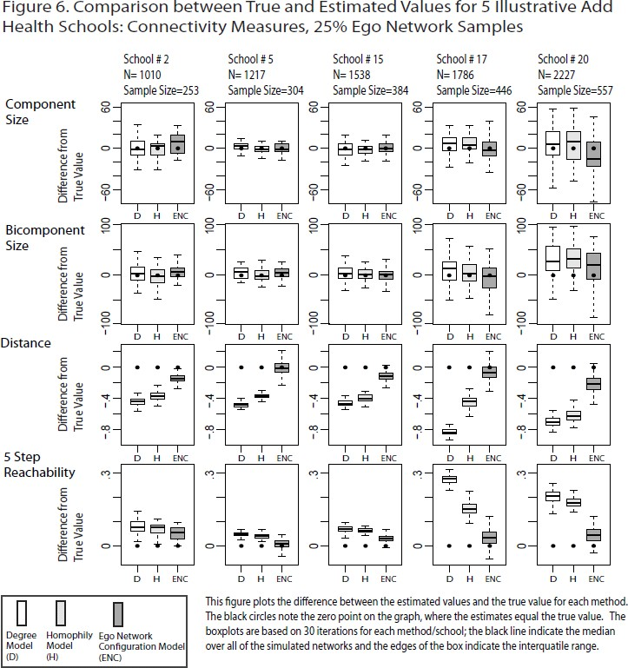

Slide 65

Summary
Ego network data are easy to collect and (potentially) useful for studying health
Offers measures of social support (related to better health outcomes)
Offers measures of risk/norms that an individual faces
Offers information that can be used for inferring full network structure
Useful in understanding risk of disease spread

